Slide 1
SPRING IOC

Slide 2
IoC container
In programming, a container is a lightweight, portable package of application code and its dependencies that allows the code to run in any computing environment. Containers can include libraries, binaries, configuration files, and frameworks.
a bean is an object that is instantiated, assembled, and managed by the Spring IoC (Inversion of Control) container.
IoC container is a framework for implementing automated dependency injection.
The IoC container is accountable to instantiate, configure and construct the objects. It gets pieces of information from the XML file and performs accordingly.

Slide 3
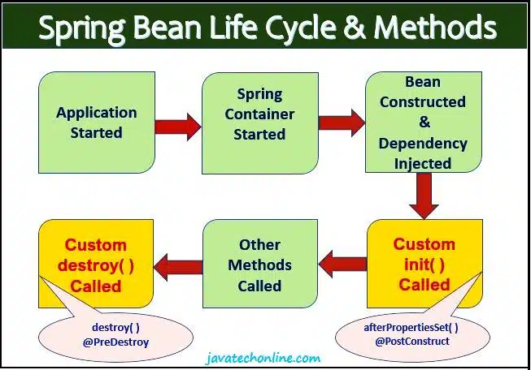
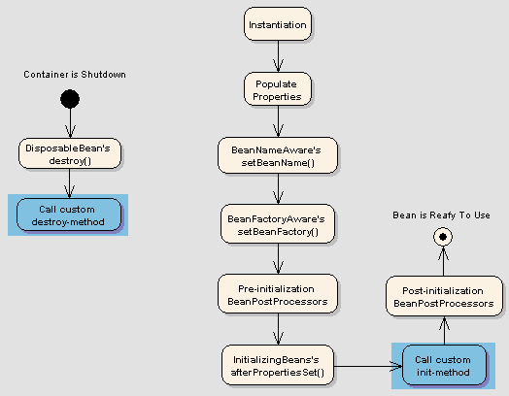
What is Lifecycle of a Bean in Spring?

Slide 4
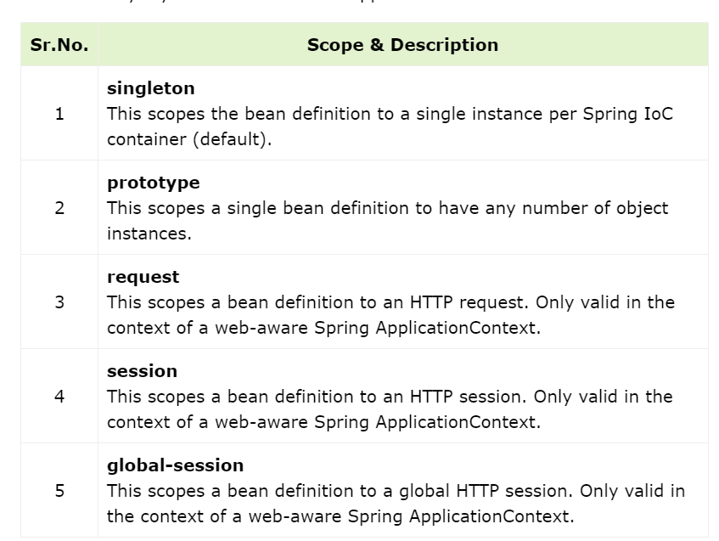

Slide 5
Understanding Inversion of Control (IoC):
With IoC, you delegate the responsibility of object creation and dependency management to the Spring container. Instead of creating objects explicitly, you define their dependencies through configuration files or annotations. The container then handles the rest, creating objects and automatically wiring dependencies during runtime.

Slide 6
Types of IOC containers
There are two types of IOC container
BeanFactory
ApplicationContext
The BeanFactory is a basic IoC container that provides basic features such as bean instantiation and dependency injection. The ApplicationContext is a more advanced IoC container that builds on top of the BeanFactory and provides additional features such as event publishing, messaging, and internationalization.

Slide 7
BeanFactory v/s Application Context
Key Features of BeanFactory
Lazy Initialization: Beans are created only when they are requested.
Lightweight: Suitable for lightweight applications, where memory usage is a critical concern.
Basic Container: Provides only fundamental functionalities like dependency injection and bean lifecycle management.
Configured using only XML file
When to Use BeanFactory
When memory consumption is a primary concern.
In standalone applications where advanced features of ApplicationContext are not required.

Slide 8
BeanFactory v/s Application Context
ApplicationContext is an extension of BeanFactory that provides additional functionalities, making it more suitable for enterprise applications. It includes all the features of BeanFactory along with several advanced features.
Key Features of ApplicationContext
Eager Initialization: Beans are created at the time of container startup by default.
Internationalization: Provides support for i18n (Internationalization) messages.
Event Propagation: Allows registering and propagating events.
AOP: Provides integration with Spring's AOP functionality.
Convenient Access: Provides easy access to ApplicationEvent publishers, MessageSource, and more.
Environment Management: Manages properties and profiles.
Configured using XML files and supports java configuration.

Slide 9
ApplicationContext VS BeanFactory
The ApplicationContext interface is constructed on top of the BeanFactory interface. It integrates some additional functionality than BeanFactory, such as easy integration with Spring's AOP, message resource handling (for I18N), event propagation, and application-layer detailed context (e.g. WebApplicationContext) for the web application. So it is more suitable to use ApplicationContext than BeanFactory.
BeanFactory contains the XmlBeanFactory class that implements for the BeanFactory interface. We can use BeanFactory to create the instance of XmlBeanFactory class as shown below:

Slide 10
Dependency Injection
It’s a design pattern that promotes the injection of dependencies into an object rather than the object creating or managing its dependencies.
It’s all about providing the necessary dependencies to an object from an external source, rather than the object creating or managing its dependencies.

Slide 11
Types of Dependencies Injection
Spring Supports three types of dependencies Injection
Contructor
Setter
Field

Slide 12
Constructor Injection
In constructor-based injection, the dependencies required for the class are provided as arguments to the constructor:
private Flavor flavor; Cake(Flavor flavor) {
Objects.requireNonNull(flavor); this.flavor = flavor;
}

Slide 13
Let’s Understand Why Constructor Injection is Better?
Immutability: Constructor injection allows you to create immutable objects. Once the dependencies are set in the constructor, they cannot be changed, leading to safer and more predictable code.
Clarity: It makes the dependencies of a class explicit. By looking at the constructor, you can immediately see what the class needs to function.
Testability: Constructor injection makes unit testing easier. You can pass in mock dependencies to isolate the class under test.
Fail Fast: Suppose a required dependency is missing or cannot be resolved. In that case, constructor injection will cause the application to fail during startup. It is considered a good practice, allowing developers to catch configuration issues early rather than discover them later during runtime.

Slide 14
Disadvantages of Constructor Injection
when a class has many dependencies. This can make the code harder to read and maintain.
Adding or removing dependencies requires modifying the constructor, which can impact other parts of the code that use the class.
Constructor injection can introduce boilerplate code, particularly in classes with many dependencies.
Less flexible: Constructor injection makes it harder to create objects with optional dependencies.
Circular dependencies: Constructor injection can lead to circular dependencies if not handled carefully

Slide 15
Setter Injection
In setter-based injection, we provide the required dependencies as field parameters to the class
and the values are set using the setter methods of the properties.
We have to annotate the setter method with @Autowired annotation
private Topping toppings;
@Autowired
void setTopping(Topping toppings) {
this.toppings = toppings;
}

Slide 16
Advantages of setter injection
Flexibility: Setter injection allows for optional dependencies. You can choose to set only the required dependencies, leaving others uninitialized if necessary. This is useful when working with complex configurations where not all dependencies are always needed.
Dynamic Configuration: Setter methods enable you to reconfigure or re-inject dependencies at runtime. This can be beneficial for managing beans through JMX MBeans, where you might need to change dependencies without restarting the application.
Circular Dependency Handling:
While not ideal, setter injection can help resolve circular dependencies in certain situations. By injecting dependencies after object creation, you can avoid the issues that arise when two or more beans depend on each other in a circular fashion.

Slide 17
Disadvantages of setter injection
Mutability:
Objects become mutable after creation. This can lead to inconsistent states, making debugging and maintenance more challenging.
Optional Dependencies:
While setter injection can be used for optional dependencies, it can also lead to confusion about which dependencies are truly required.
Readability:
Constructor injection makes it clear what dependencies a class requires, right in the constructor signature. Setter injection scatters this information throughout the class, making it harder to understand.
Circular Dependencies:
Setter injection can hide circular dependencies, which can lead to runtime errors.

Slide 18
Field Injection
With field-based injection, Spring assigns the required dependencies directly to the fields on annotating with @Autowired annotation.
@Autowired private Topping toppings;

Slide 19
AutoWiring
Autowiring is a technique used in Spring to enable automatic dependency injection
Autowiring in Spring works through a combination of mechanisms:
1 Bean Discovery:
Spring scans the application's classpath for beans annotated with @Component, @Service, @Repository, or @Controller.
It also registers beans defined in XML configuration files.
These beans are then stored in the Spring Application Context.
2 Dependency Injection:
When a bean is created, Spring examines its dependencies (fields, constructor arguments, or setter methods) annotated with @Autowired.
Spring searches the Application Context for a bean that matches the type of the dependency.
If a single matching bean is found, it is injected into the dependent bean.

Slide 20
AutoWiring
3. Autowiring Modes:
By Type: This is the default mode. Spring looks for a bean of the same type as the dependency.
By Name: Spring looks for a bean with the same name as the dependency.
By Constructor: Spring tries to find a constructor that matches the types of the dependencies.
No: Autowiring is disabled. You must explicitly configure dependencies.
4. Resolving Ambiguity:
If multiple beans of the same type exist, Spring uses the @Qualifier annotation to resolve the ambiguity.
The @Qualifier annotation allows you to specify the bean name or a custom qualifier.
5. BeanPostProcessors:
Spring uses AutowiredAnnotationBeanPostProcessor to process the @Autowired annotations.
This post-processor is responsible for injecting the dependencies into the beans.

Slide 21
Types Of Autowire
By Type:
Spring looks for a bean of the same type as the property being injected. If multiple beans of the same type exist, an exception is thrown.
Example: @Autowired private MyService myService;
By Name:
Spring matches the property name to the bean name in the application context. If no matching bean name is found, an exception is thrown.
Example: @Autowiredprivate MyService myServiceBean; // Assuming a bean with name "myServiceBean" exists
Constructor:
Spring injects dependencies through the constructor. The constructor arguments are matched by type.
If there are multiple constructors, Spring chooses the one with the most arguments.
Example: @Autowiredpublic MyClass(MyService myService) { this.myService = myService;}

Slide 22
Types Of Autowire
Autodetect (Deprecated):
Spring tries to determine the best autowiring strategy automatically. It first tries constructor autowiring, then byType.
This approach is not recommended due to its unpredictable behavior.
No Autowiring:
Dependencies are explicitly defined through XML or Java configuration. This provides the most control but requires more manual effort.
The autodetect option in Spring is deprecated because it provides too much "magic" and a more explicit declaration is preferred. The autodetect mode uses two other modes for autowiring, constructor and byType. It first tries to autowire via the constructor mode and if it fails, it uses the byType mode for autowiring. This option was used for autowire by constructor or byType, as determined by Spring container. Since there are already so many options, this option is deprecated.

Slide 23
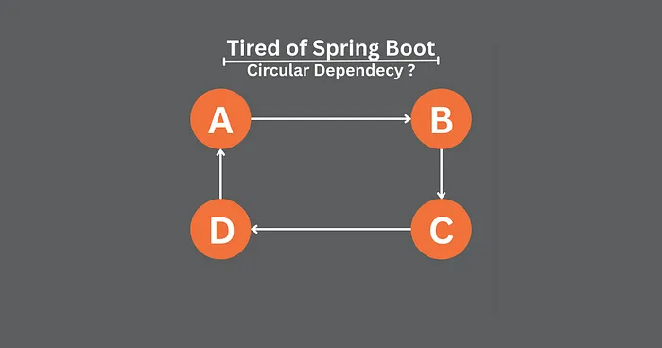
What is Circular Dependency?
Circular dependency is a situation where two or more beans depend on each other in a way that forms a loop

Slide 24
What is Circular Dependency? Contd..
In Spring Boot, circular dependency can occur in three ways:
Constructor injection: When a bean A requires another bean B in its constructor and bean B requires bean A in its constructor, a circular dependency occurs.
Setter injection: When bean A requires bean B through a setter method and bean B requires bean A through another setter method, a circular dependency occurs.
Field injection: When bean A requires bean B through a field and bean B requires bean A through another field, a circular dependency occurs.

Slide 25
What is Circular Dependency? Solution fixing
Method 1: Refactoring: One way to fix circular dependency is to refactor your code to remove the circular reference. This can be done by extracting the shared functionality into a separate class or interface, which can be injected into both classes that previously had the circular reference.
Method 2: Setter Injection: Another way to fix circular dependency is to use setter injection instead of constructor injection. With setter injection, Spring Boot will first create the object and then set the required dependencies using the setter method.
Method 3: Lazy Initialization: Another way to fix circular dependency is to use lazy initialization. With lazy initialization, Spring Boot will create the object only when it is first used, instead of creating it immediately at application startup. This can help break the circular reference by delaying the creation of one or more of the objects until they are actually needed.

